Slide 1
ECE 4140/6240
VLSI Design and Simulation
Professor M. E. Zaghloul
Fall 2024
M.E.Zaghloul

Slide 2
Professor Zaghloul Information and TA information
Office 5th floor SEH building Rm 5550
Office Hours W 2-3pm
email: zaghloul@gwu.edu
Class Lectures will be placed on BB every week
M.E.Zaghloul

Slide 3
TA Information
TA for the Course
Name:
TA will be at the class lab every week
M.E.Zaghloul

Slide 4
COURSE Outline
Detailed course outline is given for each week, see the Course outline listed on BB
Please read and see the requirement for the course
Work in this course is mostly laboratory to design and implement CMOS chip-and a Class project
M.E.Zaghloul

Slide 5
Project Course
Students Design Actual Chip
Chips are designed for possible fabrication by the END of the semester DECEMBER 7 , the PROJECT Chip Design is DUE .
Projects are Digital Circuits Design (40% of your grade). Groups of students are allowed up to TWO students per project.
M.E.Zaghloul

Slide 6
ECE 4150 Sequel Course
Sequel Course may be taken for graduate credit. ASIC Design using HDL language and Standard library
We have to test the fabricated chips to learn about our mistakes. Physical testing is done for fabricated chips. (We are not sure of fabrication fundings).
For ECE 4140/6240 project you have to think about testing and must add parts to simplify the test the chip.
M.E.Zaghloul

Slide 7
LIST OF IC Design Courses in GWU-ECE
ECE 4140/6240 is the prerequisite for all basic Chip layout and design courses.
ECE4150 ASIC design and Testing using library and HDL For Design
ECE 6213 FPGA design and large projects
ECE 6214 Low power design
ECE 6215 MEMS (sensors design basics) design course using CAD tools (COMSOL)
ECE 6216 RF IC design
ECE 6218 Advanced Analog Design
M.E.Zaghloul

Slide 8
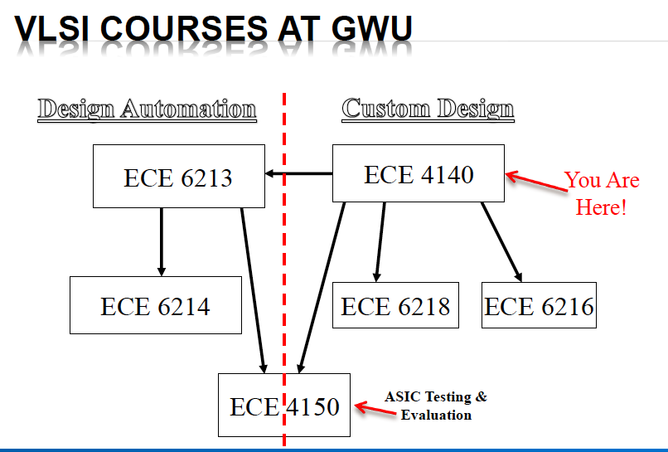
M.E.Zaghloul

Slide 9
Technology used CMOS Design
CMOS means both NMOS and PMOS transistors are on the chip
Minimum Feature size on the chip is 0.5 micron( in this course). This is old technology
Size of the chip is TINY Chip you can have more than 4000 transistor depending on the technology
Your Project must be in the range of 3000 transistors
40 Pins are all what you have and the chip area is about
1.2mm x 1.2mm
M.E.Zaghloul

Slide 10
VLSI
Very-Large-Scale Integration Circuits
There are different Technologies for circuit design; example CMOS, Bipolar, GaAs, BiCMOS, we will concentrate only on CMOS TECHNOLOGY
CAD tools used in the course will be discussed in the lab
CADENCE CAD tools. Schematic editor, HDL Verilog-x for simulation, and Layout editor, Layout VS Schematic.
There are many tools to design VLSI Project. In this course we are concentrating on CADENCE
M.E.Zaghloul

Slide 11
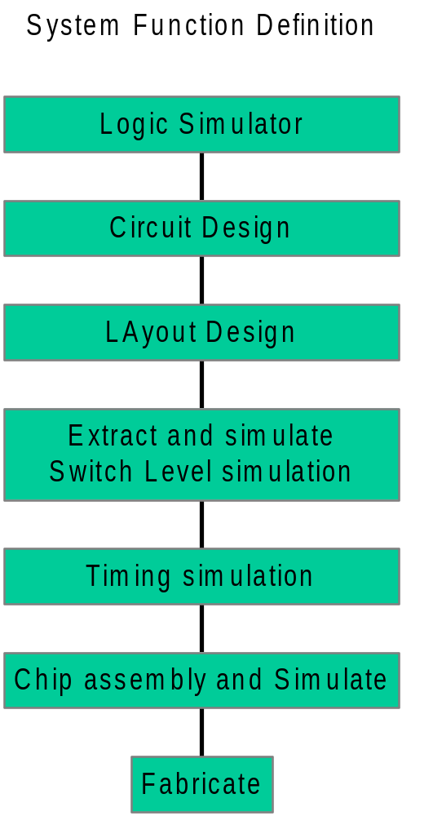
Chip Design Sequence
Architecture Design
Physical Design
M.E.Zaghloul

Slide 12
NMOS Transistor
Gate Poly
S
G
D
n+
p
n+
M.E.Zaghloul

Slide 13
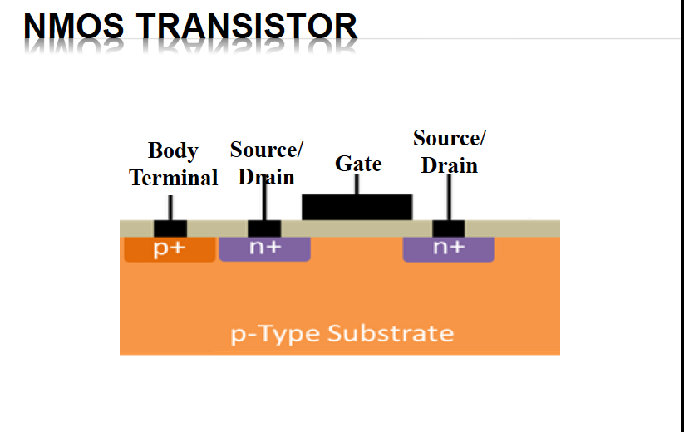
M.E.Zaghloul

Slide 14
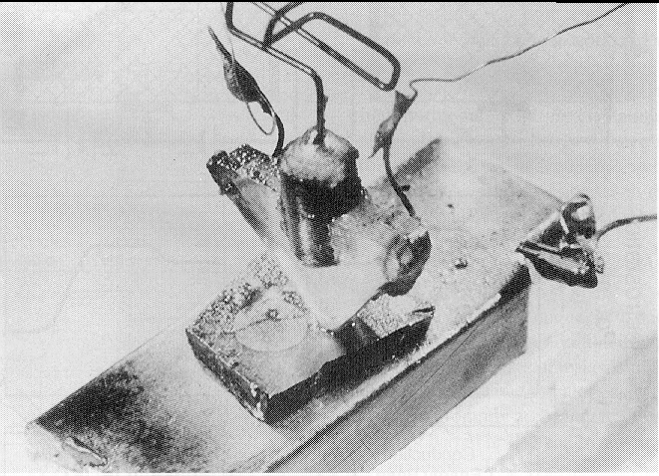
The Transistor Revolution
First transistor
Bell Labs, 1948
M.E.Zaghloul

Slide 15
Moore’s Law
In 1965, Gordon Moore noted that the number of transistors on a chip doubled every 18 to 24 months.
He made a prediction that semiconductor technology will double its effectiveness every 18 months
M.E.Zaghloul

Slide 16
Transistor Counts
1 Billion Transistors
K
1,000,000
100,000
Pentium® III
10,000
Pentium® II
Pentium® Pro
1,000
Pentium®
i486
100
i386
80286
10
8086
Source: Intel
1
1975
1980
1985
1990
1995
2000
2005
2010
Projected
M.E.Zaghloul
Courtesy, Intel

Slide 17
Moore’s law in Microprocessors
1000
100
2X growth in 1.96 years!
10
P6
Transistors (MT)
Pentium® proc
1
486
386
0.1
286
Transistors on Lead Microprocessors double every 2 years
8085
8086
0.01
8080
8008
0.001
4004
1970
1980
1990
2000
2010
Year
M.E.Zaghloul
Courtesy, Intel

Slide 18
Die Size Growth
100
P6
Die size (mm)
486
Pentium ® proc
10
386
8080
286
8086
~7% growth per year
8085
8008
~2X growth in 10 years
4004
1
1970
1980
1990
2000
2010
Year
Die size grows by 14% to satisfy Moore’s Law
M.E.Zaghloul
Courtesy, Intel

Slide 19
Power Dissipation
100
P6
Pentium ® proc
10
286
486
Power (Watts)
8086
386
8085
1
8080
8008
4004
0.1
1971
1974
1978
1985
1992
2000
Year
Lead Microprocessors power continues to increase
M.E.Zaghloul
Courtesy, Intel

Slide 20
Power is a major problem
100000
18KW
10000
5KW
1.5KW
1000
500W
Pentium® proc
Power (Watts)
100
286
486
10
8086
386
8085
8080
1
8008
4004
0.1
1971
1974
1978
1985
1992
2000
2004
2008
Year
Power delivery and dissipation will be prohibitive
M.E.Zaghloul
Courtesy, Intel

Slide 21

Challenges in Digital Design
“Microscopic Problems”
• Ultra-high speed design
Interconnect
• Noise, Crosstalk
Leakage problems
• Reliability, Manufacturability
• Power Dissipation
• Clock distribution.
Everything Looks a Little Different
“Macroscopic Issues”
• Time-to-Market
• Millions or more of Gates
• High-Level Abstractions
• Reuse & IP: Portability
• Predictability
• etc.
…and There’s a Lot of Them!
?

Slide 22
Why Scaling?
Technology shrinks by 0.7/generation
With every generation can integrate 2x more functions per chip; chip cost does not increase significantly
Cost of a function decreases by 2x
But …
  How to design chips with more and more functions?
  Design engineering population does not double every two years…
Hence, a need for more efficient design methods
  Exploit different levels of abstraction
M.E.Zaghloul

Slide 23
Design Metrics
How to evaluate performance of a digital circuit (gate, block, …)?
  Cost
  Reliability
  Scalability
  Speed (delay, operating frequency)
  Power dissipation
  Energy to perform a function
M.E.Zaghloul

Slide 24
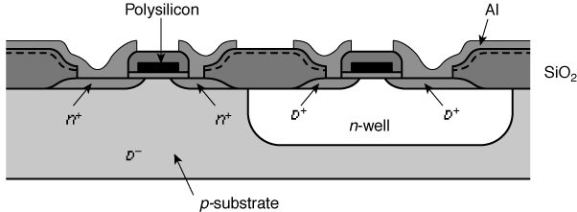
Cross-Section of CMOS Technology
P and N Type Inverter
M.E.Zaghloul

Slide 25
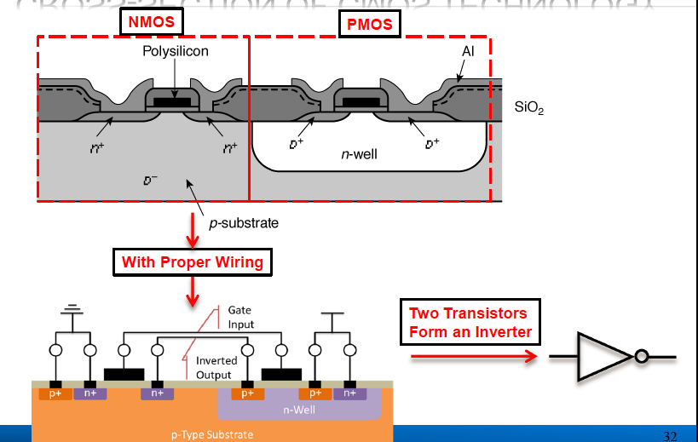
M.E.Zaghloul

Slide 26
3-Dimension Transistor note the colors indicate different material
GATE Poly Red
n+
diffusion
Green
W
L
M.E.Zaghloul

Slide 27
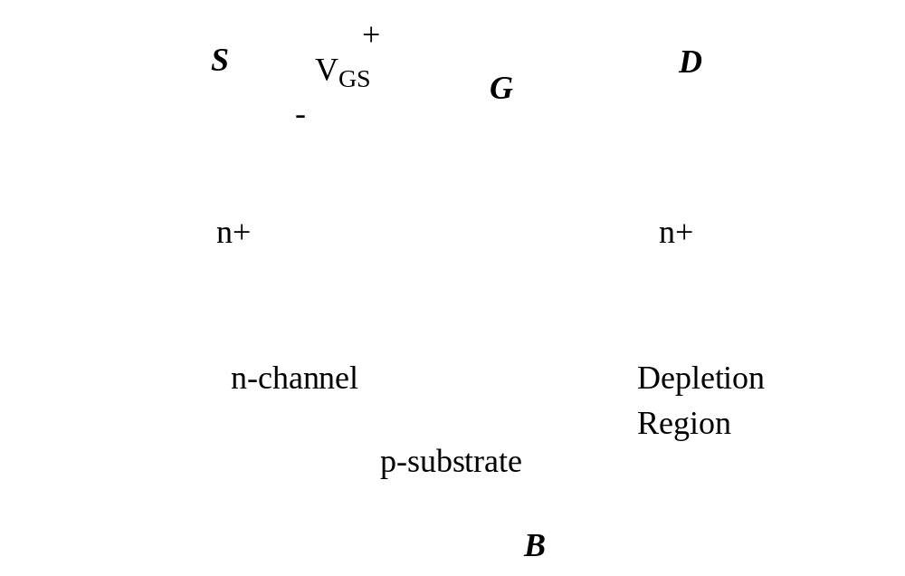

Threshold Voltage: Concept
M.E.Zaghloul

Slide 28
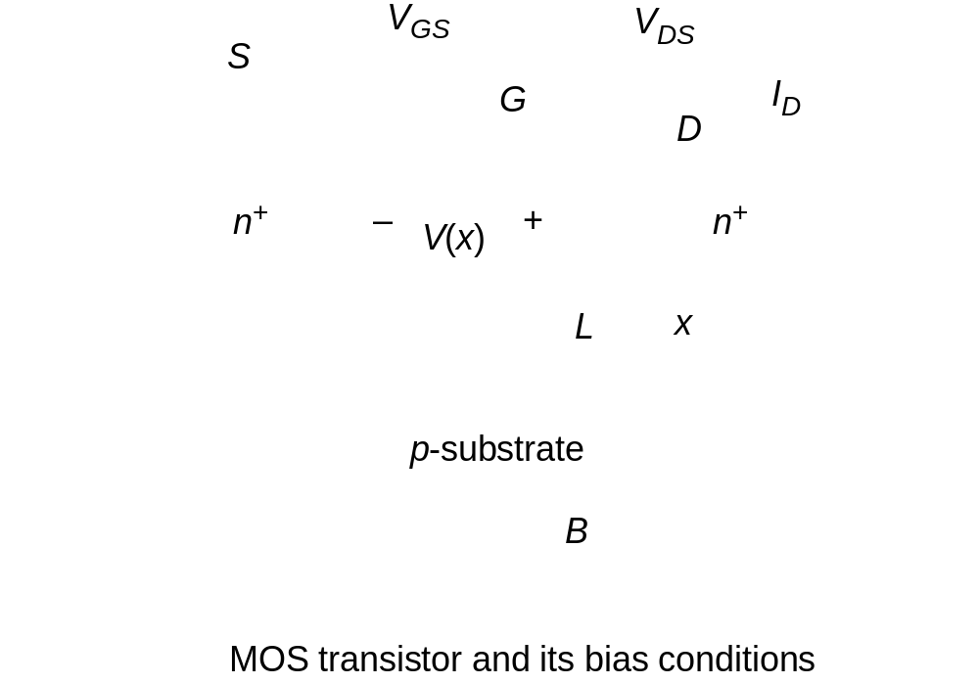
Current-Voltage Relations
TOX
TOX
M.E.Zaghloul

Slide 29
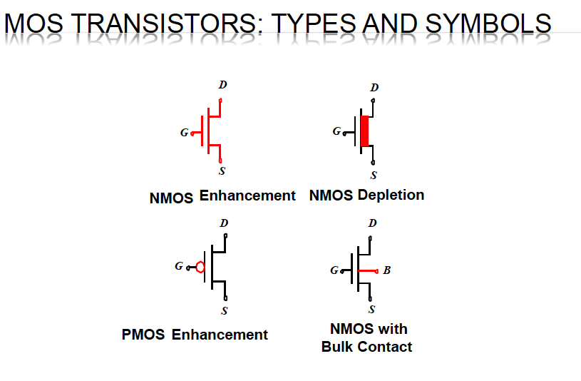
M.E.Zaghloul

Slide 30
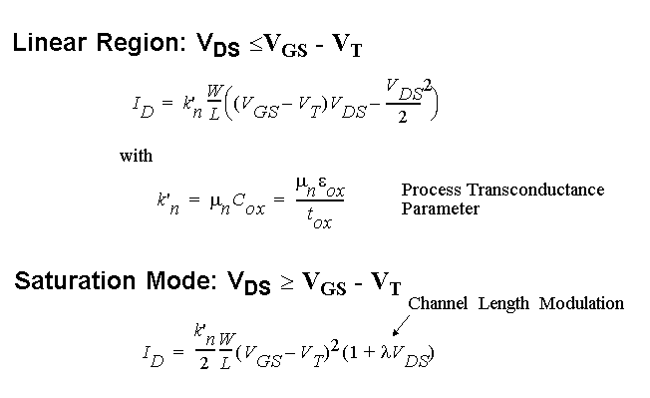
Current-Voltage Relations
M.E.Zaghloul

Slide 31
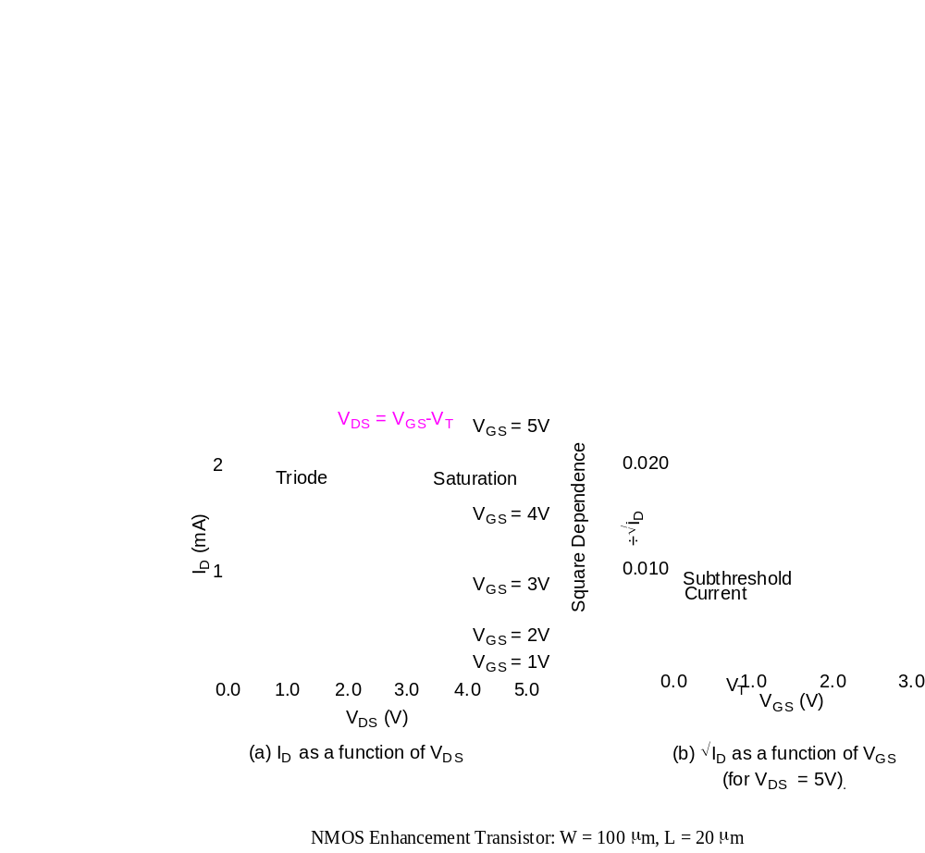
I-V Relation
M.E.Zaghloul

Slide 32
Digital Design Review
How to realize complex function in CMOS
Using p-type and n-type transistors how to realize complex Boolean function
M.E.Zaghloul

Slide 33
MOS Transistors Switch
N-Switch
G = 0
Switch open
G = 1
Switch Closed
M.E.Zaghloul

Slide 34
MOS Transistors Switch
P-Switch
G = 1
Switch open
G = 0
Switch Closed
M.E.Zaghloul

Slide 35
INVERTER
VDD = 1
P-Switch
IN
OUT
N-Switch
IN Out
0 1
1 0
VSS = 0
M.E.Zaghloul

Slide 36
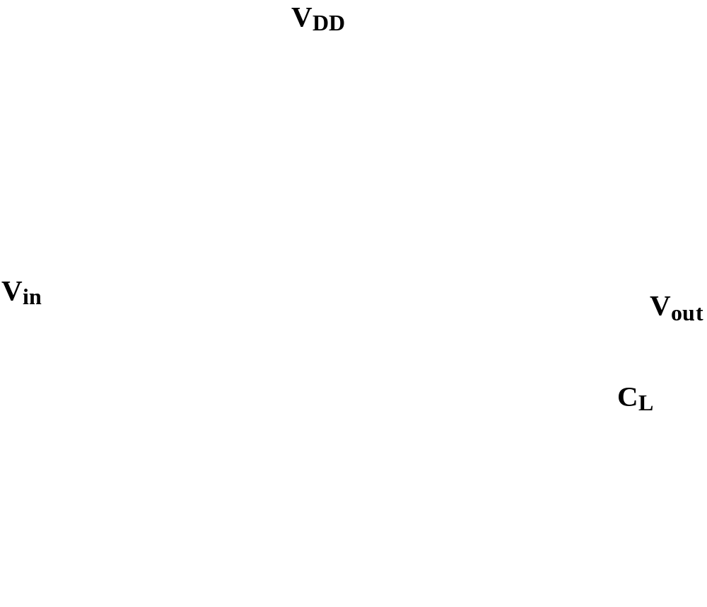
The CMOS Inverter:
A First Glance
M.E.Zaghloul
Notes:
Notice that the two transistors are modeled as a switch with finite ON resistance. When the gate voltage is greater than the threshold voltage the switch is ON

Slide 37
Circuit Layout
In this course you are designing the layout of circuit design for a project using VLSI-CAD tools
Layout are really telling the fab the information about each layer in the chip Fabrication steps
Usually there are different materials layers to be used
Each material is coded by specific color in the CAD tool
You specify the length, width, the shape, and the contacts of each layer to other layers in the design.
M.E.Zaghloul

Slide 38
Cross-Section of CMOS Technology
P and N Type
Side View
M.E.Zaghloul

Slide 39
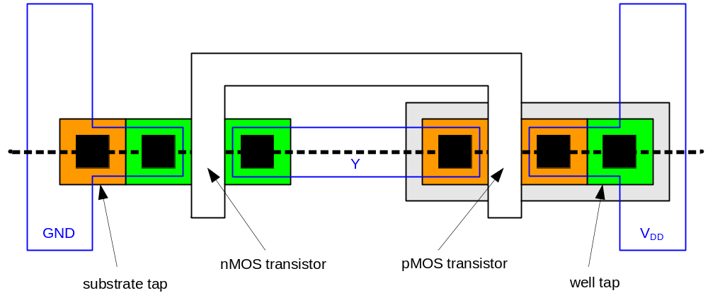
Inverter Mask Set
Transistors and wires are defined by masks
Cross-section taken along dashed line
0: Introduction

Slide 40
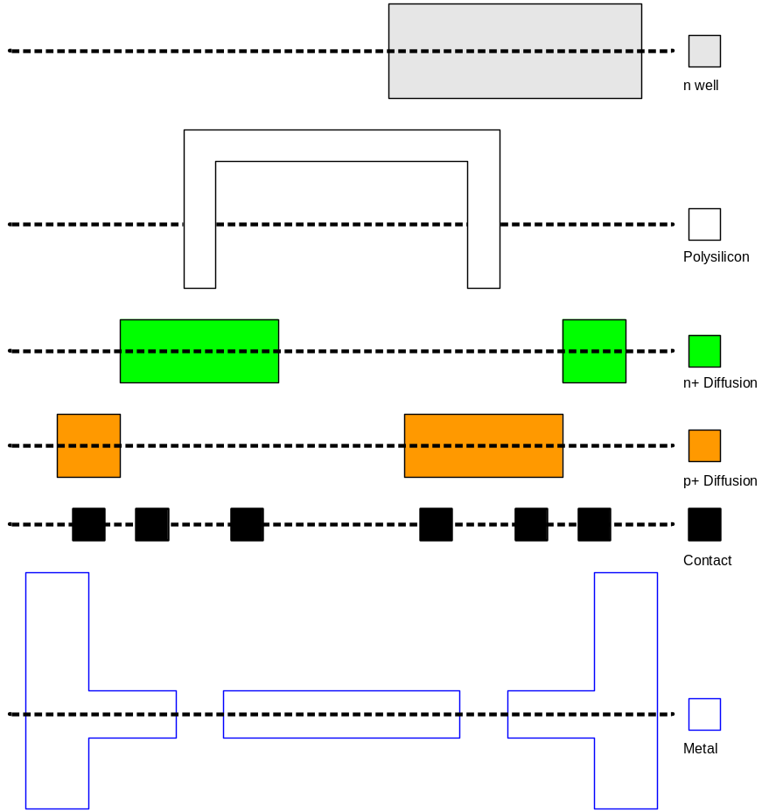
Detailed Mask Views
Six masks
  n-well
  Polysilicon
  n+ diffusion
  p+ diffusion
  Contact
  Metal
0: Introduction

Slide 41

Fabrication
Chips are built in huge factories called fabs
Contain clean rooms as large as football fields
Courtesy of International
Business Machines Corporation. IBM
Unauthorized use not permitted.
0: Introduction

Slide 42
Why CMOS
No DC Current
Power is independent of Transistors Size
No Ratio
Most of the chips of today are in CMOS technology
Today Feature size is 7 nanometer soon will be 2 nanometer
M.E.Zaghloul

Slide 43
Cross-Section of CMOS Technology
M.E.Zaghloul

Slide 44
Combinational Logic
Placing N-switches and P-Switches you can realize any logic
N-Switches in series realize Boolean AND
N-Switches in parallel realize Boolean OR
Complex structures can realize complex logic equations
M.E.Zaghloul

Slide 45
AND Gates
a
Path a-b is connected only if S1 and S2 are both closed
N-switch
S1
S2
S1.AND.S2
b
CASE of the P-Switch
M.E.Zaghloul

Slide 46
OR GATE
a
Path a-b is connected if S1 OR S2 is On or Both
S1
S2
N-Switches
b
M.E.Zaghloul

Slide 47
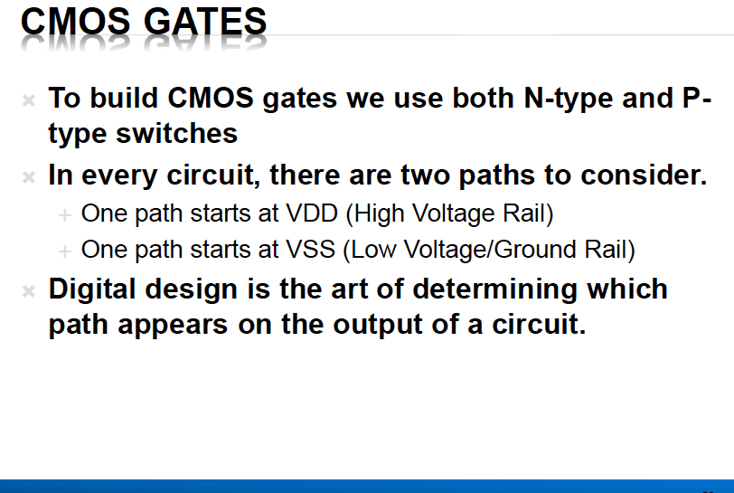
M.E.Zaghloul

Slide 48
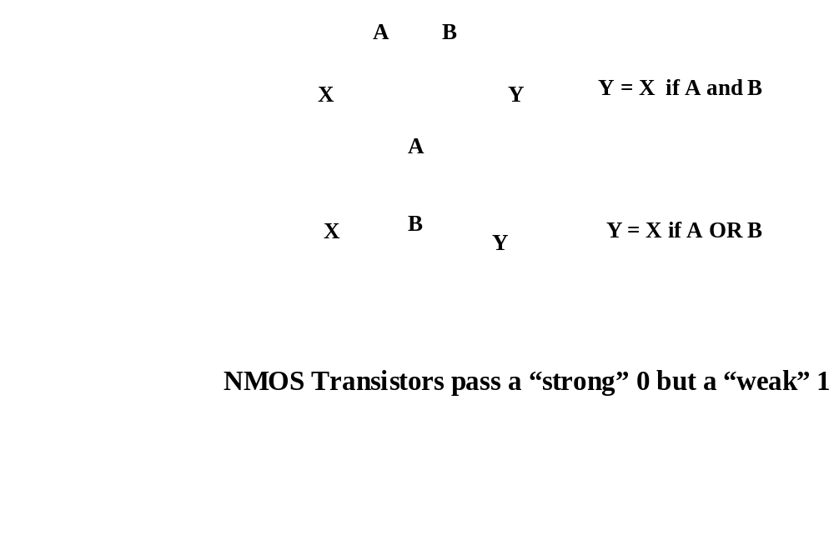
NMOS Transistors in Series/Parallel Connection
    Transistors can be thought as a switch controlled by its gate signal
    NMOS switch closes when switch control input is high
M.E.Zaghloul

Slide 49
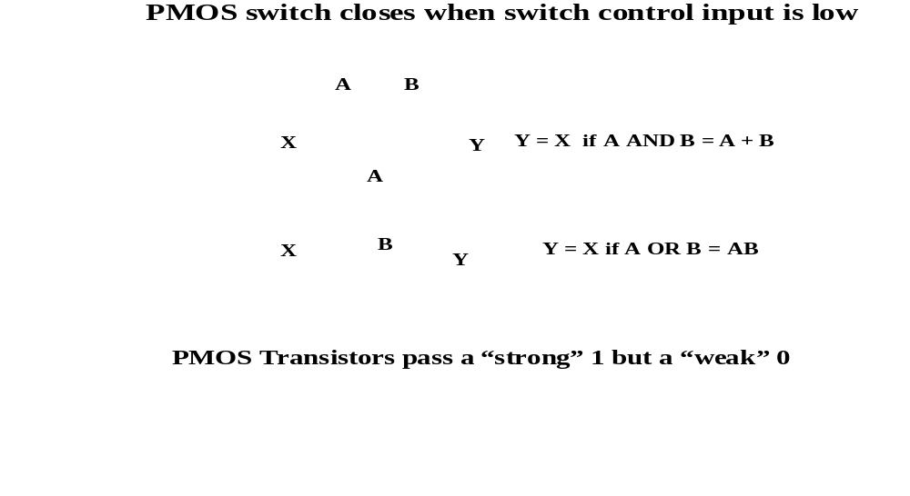
PMOS Transistors in Series/Parallel Connection
M.E.Zaghloul

Slide 50
CMOS Gates
To build CMOS gates we use both N-switch and P-switch
We have two paths one from VDD and the other from VSS
All what we are doing in Digital design we are connecting output node to either VDD or VSS depending on the path
M.E.Zaghloul

Slide 51
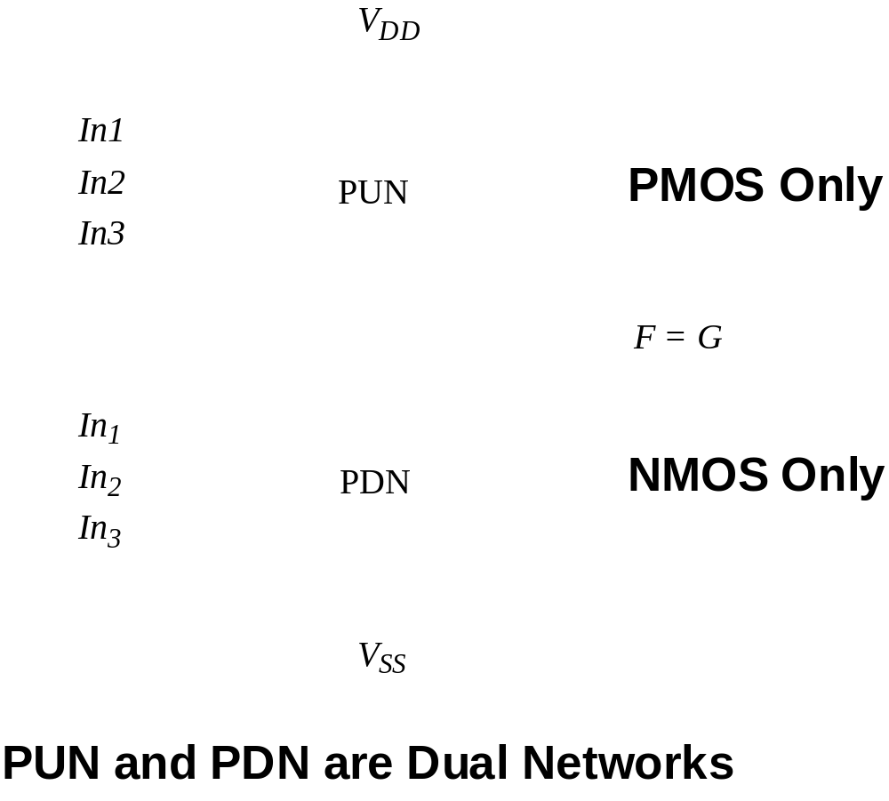
Static CMOS
M.E.Zaghloul

Slide 52
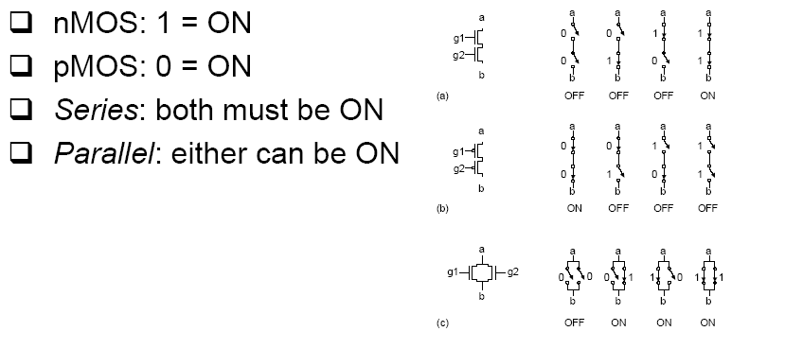
Series and Parallel
M.E.Zaghloul

Slide 53
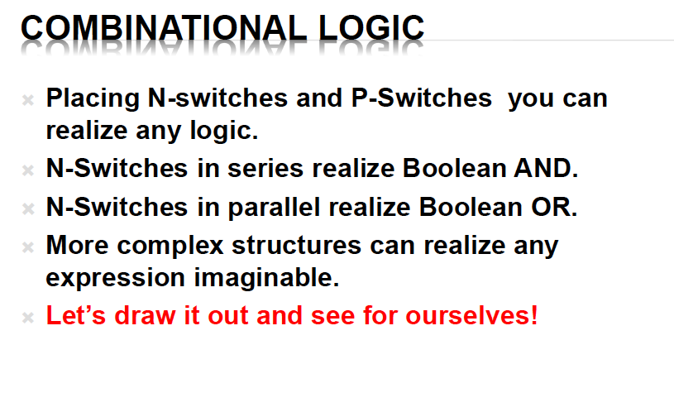
M.E.Zaghloul

Slide 54
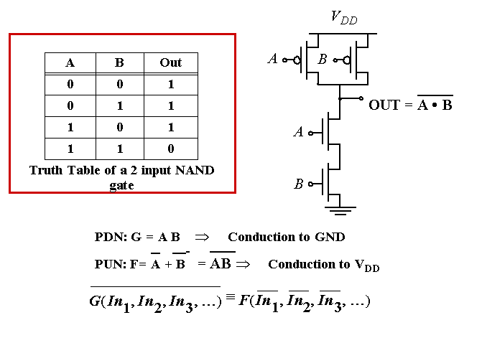
Example Gate: NAND
M.E.Zaghloul

Slide 55
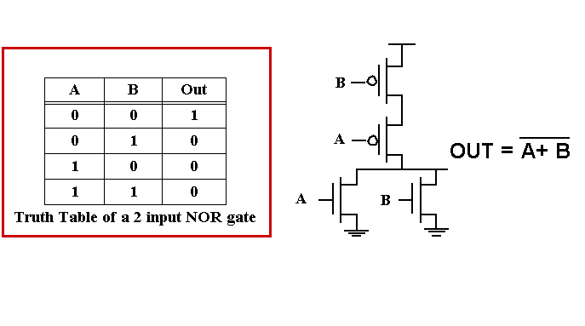
Example Gate: NOR
M.E.Zaghloul

Slide 56
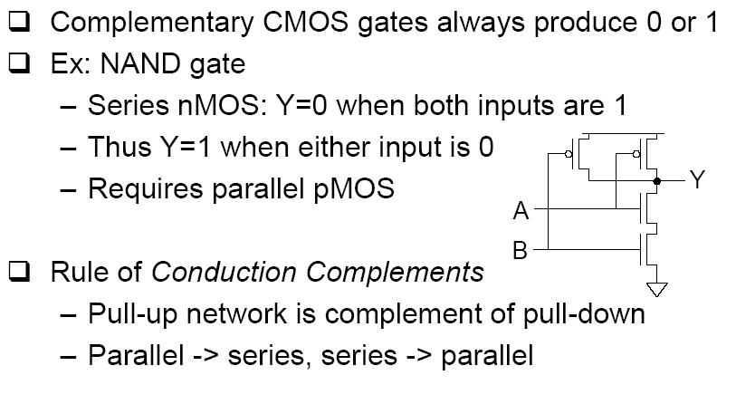
NMOS and PMOS
M.E.Zaghloul

Slide 57
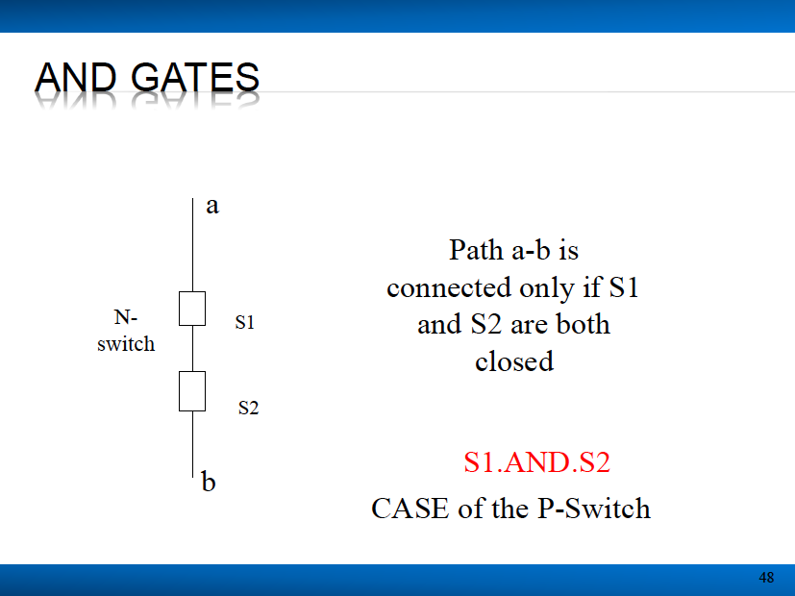
M.E.Zaghloul

Slide 58
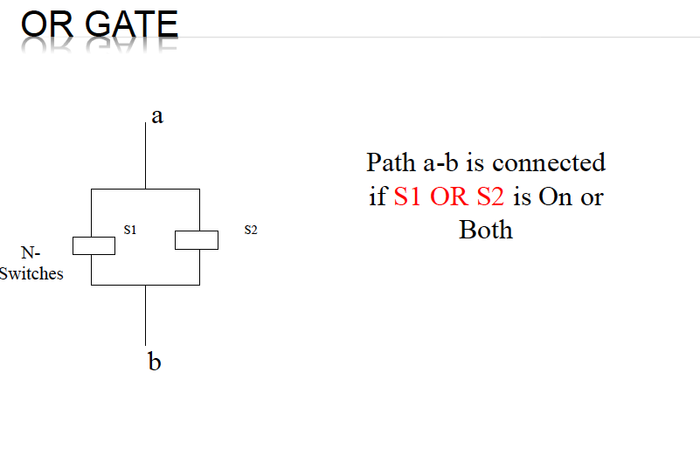
M.E.Zaghloul

Slide 59
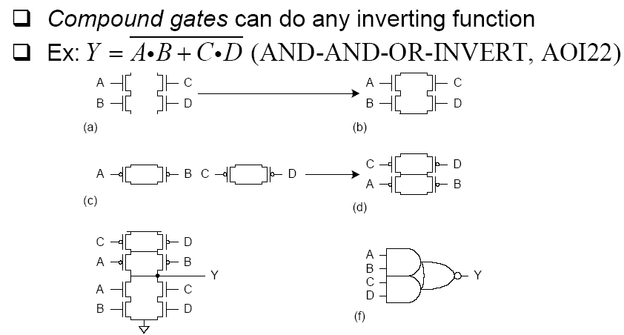
Compound Gates
M.E.Zaghloul

Slide 60
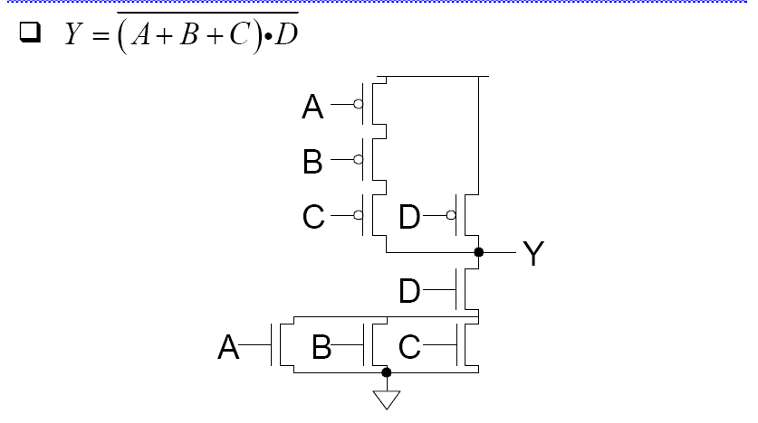
EXAMPLE
M.E.Zaghloul

Slide 61
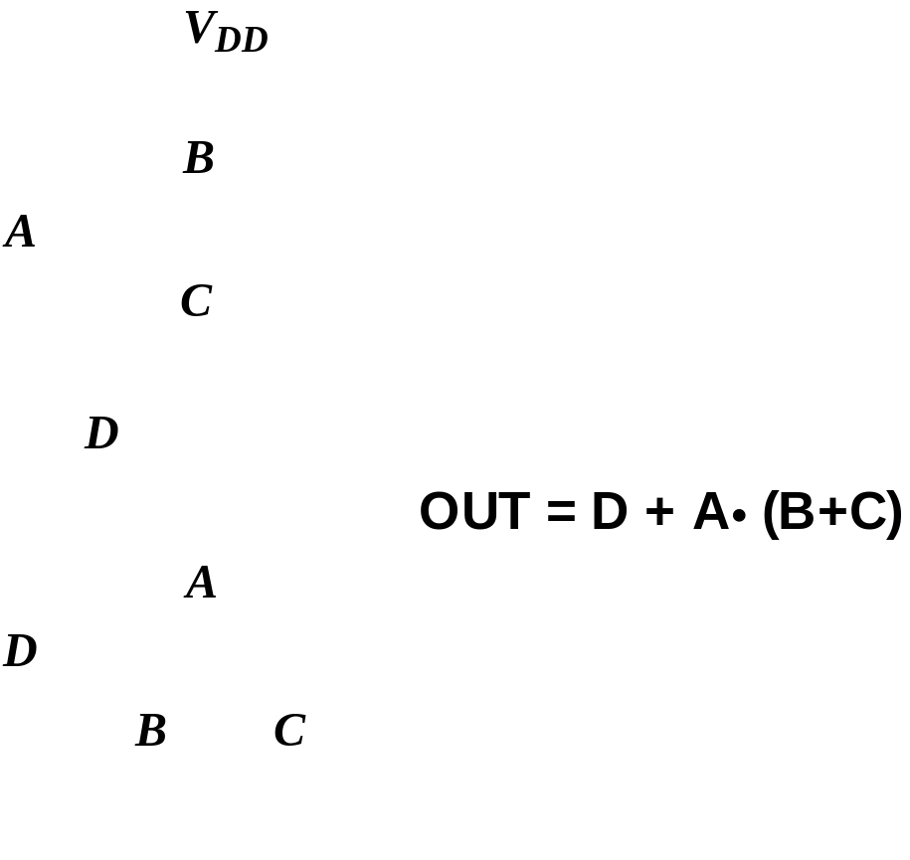
Example Gate: COMPLEX CMOS GATE
M.E.Zaghloul

Slide 62

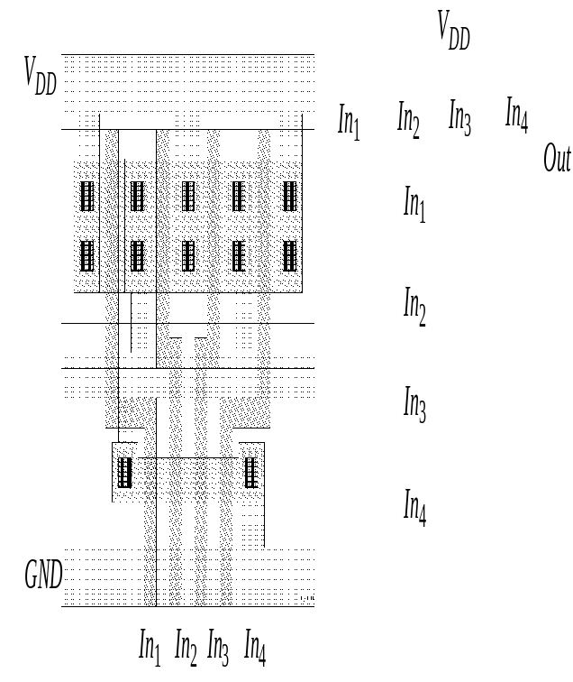
4-input NAND Gate-Layout
Vdd
Out
GND
In1
In2
In3
In4
M.E.Zaghloul

Slide 63
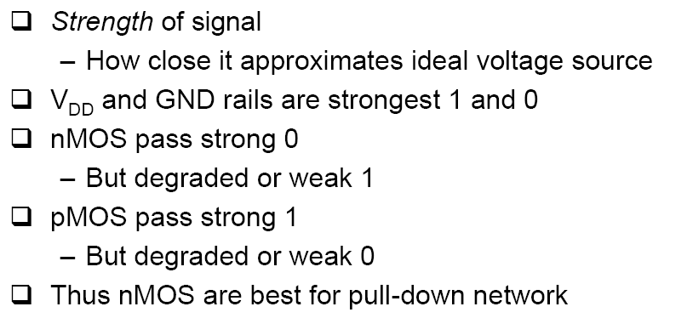
Signal Strength
M.E.Zaghloul

Slide 64
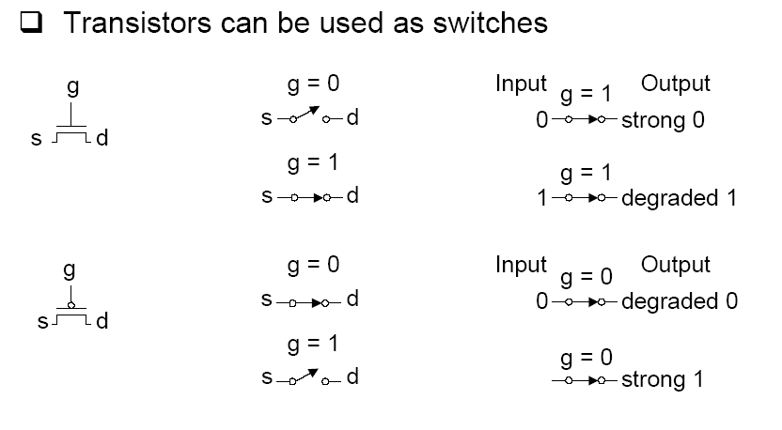
Pass Transistor
M.E.Zaghloul

Slide 65
Multiplexers
Complementary switches may be used to select between two inputs
A
OUT
B
Trans Gate Switch
M.E.Zaghloul

Slide 66
Transmission Gate Switch
Two switches N- Switch and P-Switch in Parallel
Select-B
P
a
b
N
Select
Select = 1
Select-B = 0
Path from a –to- b
M.E.Zaghloul

Slide 67
Design 2X1 of Multiplexer
M.E.Zaghloul

Slide 68
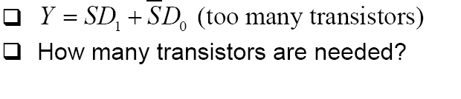
Boolean Equation Level Multiplexer
M.E.Zaghloul

Slide 69
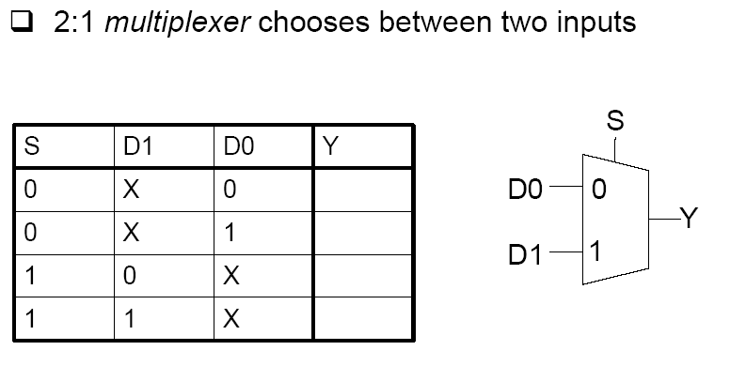
Multiplexer
M.E.Zaghloul

Slide 70
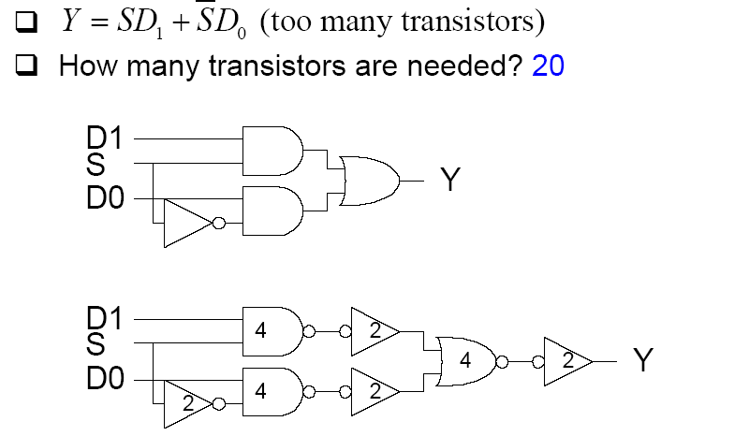
Gate Level Multiplexer
M.E.Zaghloul

Slide 71
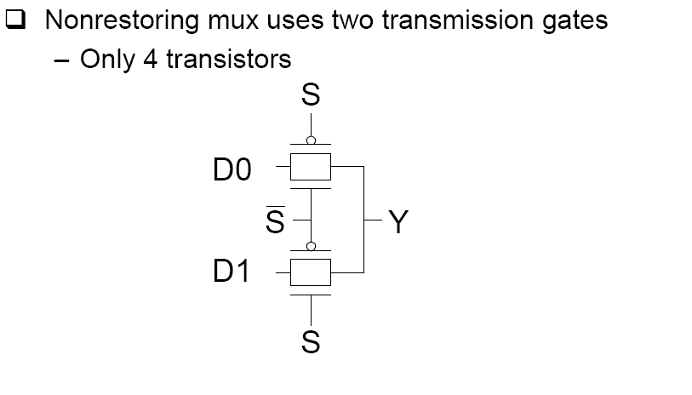
TG –MULTIPLEXER
USE Transmission Gate
M.E.Zaghloul

Slide 72
2X1 Multiplexer
TG Design 4 Transistors
2X1 MUX
-S
A
TG
OUT
S
B
TG
2-inputs and one output
-S
M.E.Zaghloul

Slide 73
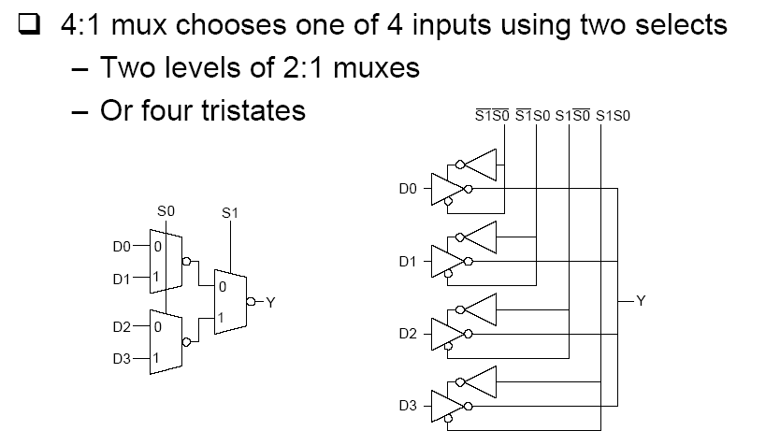
4:1 MUX
M.E.Zaghloul

Slide 74
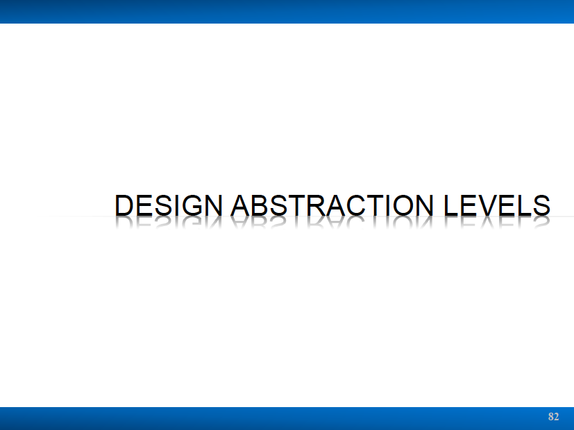
M.E.Zaghloul

Slide 75
Physical Representation
Layout
Specifies the Physical layout of components
Physical layout may be defined by rectangle or polygon that specifies the geometry of the materials to realize a specific components
This course is about the physical Design of circuits
You are learning layout of IC and how to assemble chips in this course
M.E.Zaghloul

Slide 76
Design at the Nano Scale Transistor
Possible Problems
Threshold voltage Variations
Parasitic Resistance due to layout of the device
Mobility variations material property (fabrication)
Subthreshold Conduction
M.E.Zaghloul

Slide 77
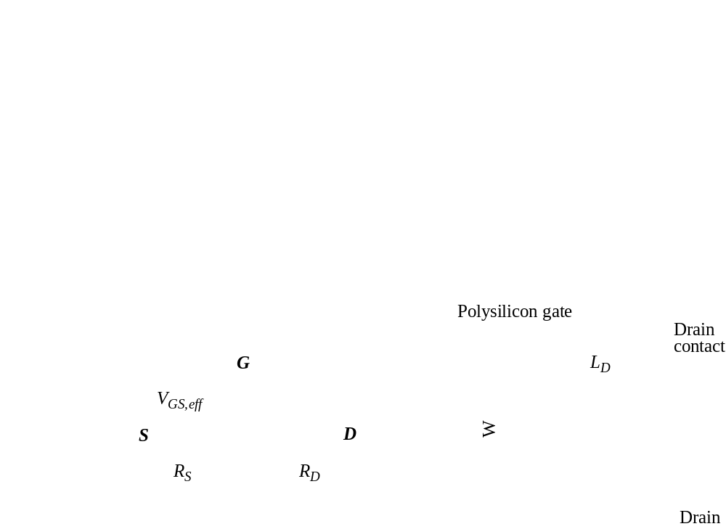
Parasitic Resistances
M.E.Zaghloul

Slide 78
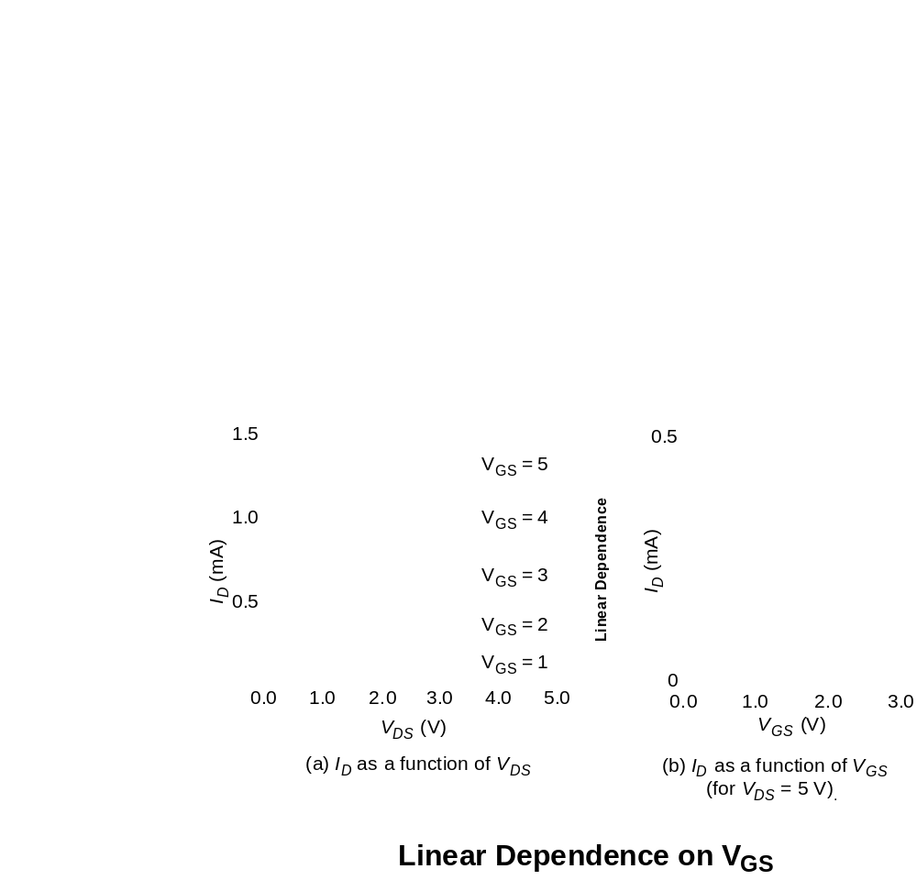
Velocity Saturation (2)
M.E.Zaghloul

Slide 79
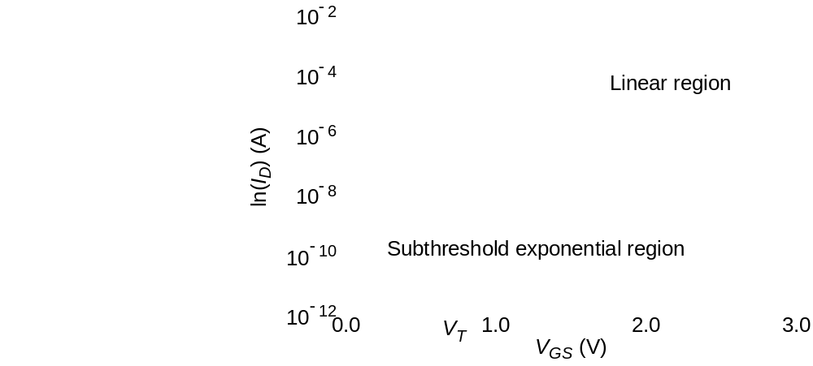
Sub-Threshold Conduction
M.E.Zaghloul

Slide 80
Summary
Digital integrated circuits have come a long way and still have quite some potential left for the coming decade
Some interesting challenges ahead moving toward nanoelectronics
  Getting a clear perspective on the challenges and potential solutions is the purpose of this course
Understanding the design metrics that govern digital design is crucial
  Cost, reliability, speed, power and energy dissipation
M.E.Zaghloul

Slide 81
Next Class
Parts of Chapter 2
Brief Description of CMOS fabrication
Laboratory every week
Chapter 11 in the book is good reference for possible project.
M.E.Zaghloul

